Slide 1

2024 Mid-Year City Progress Analysis
Contains information licensed under the Open Government Licence – City of Calgary. Data analysis of the 2024 Mid-Year Progress of Calgary's Budget performance measures. All data is owned by the City of Calgary and is used under the Open Government License.
By Hannan Hassan

Slide 2
Disclaimer
Contains information licensed under the Open Government Licence – City of Calgary. Data analysis of the 2024 Mid-Year Progress of Calgary's Budget performance measures. All data is owned by the City of Calgary and is used under the Open Government Licence.
Data Licence URL: https://data.calgary.ca/d/Open-Data-Terms/u45n-7awa
For more information visit: https://data.calgary.ca/stories/s/u45n-7awa
I am not endorsed by the City of Calgary, this data is simply used for learning purposes. This is NOT an official analysis from the City of Calgary.

Slide 3
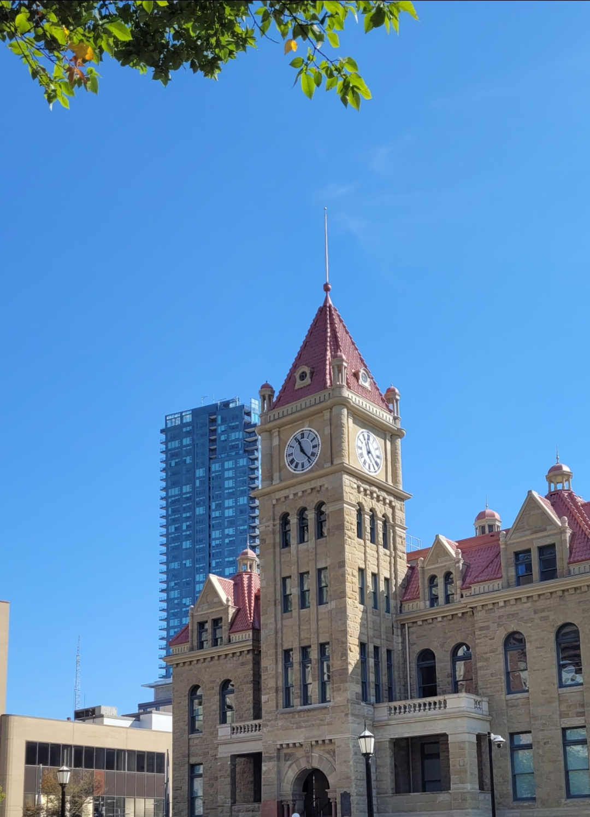
Table of Contents
Overview……………………….….4
Methodology…………….….……..5
Interpreting Results….….….…….6
Limitations and Future Study……9
References………………………..10

Slide 4
Overview
Research Questions:
What is the status of Calgary’s development as of 2024?
How are social equity, climate, transit and housing issues being dealt with?
How does data from 2023 compare to 2024 and future initiatives planned by the city?

Slide 5
Methodology
In order to address the aforementioned research questions, the 2024 Mid-Year City Progress data was obtained in CSV format from the City of Calgary's Open Data portal. Subsequently, the data was queried to establish a database within Microsoft SQL Server Management Studio. Following the creation of the database, the data was imported into Microsoft Power BI to develop an interactive dashboard that visualizes the key findings. Furthermore, previously conducted spring and fall 2024 surveys of Calgary residents were employed as supplementary information to enhance insights for future policy recommendations.

Slide 6
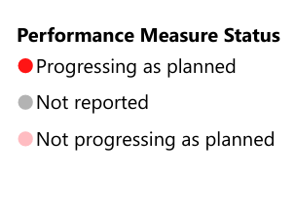
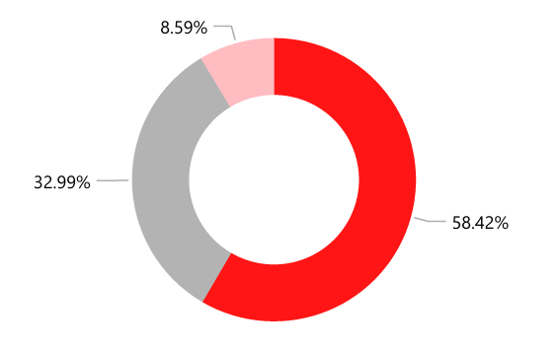
Interpreting Results
Currently, 58.42% of performance measures are on track to meet their objectives. However, 8.59% are experiencing setbacks due to various challenges. Additionally, 32.99% of plans have not been reported, primarily due to insufficient data availability. (2024 Mid-Year Progress Update)

Slide 7
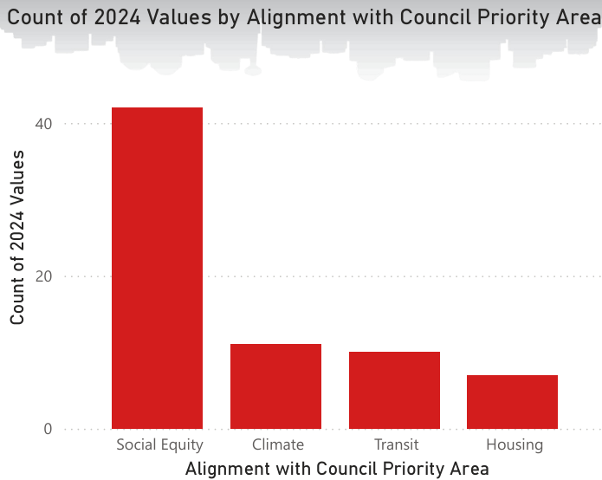
Interpreting Results
The 2024 Mid-Year analysis presents a wide range of reported categories, but I will concentrate on four critical areas: social equity, climate, transit, and housing issues, all of which are significant to the residents of Calgary. The accompanying graph indicates a strong emphasis on social equity relative to the other three issues. These findings reflect the priorities of the City Council, which may not necessarily align with the priorities of Calgary's citizens.

Slide 8
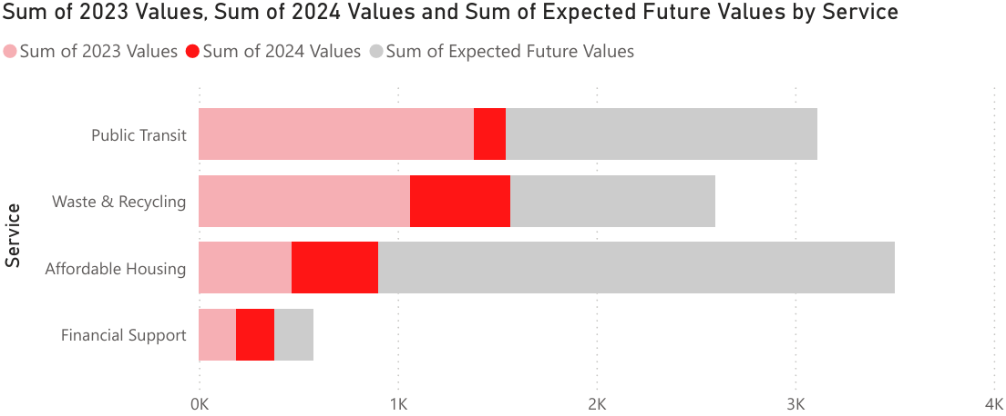
Interpreting Results
In analyzing the service values for 2024, a notable trend emerges: there are significantly fewer values recorded compared to 2023. This observation suggests that many initiatives and plans did not advance as anticipated throughout 2024. In response, the city appears to be strategizing for an increase in service values in the coming years. Specifically, critical areas such as public transit, water and recycling services, and affordable housing require urgent attention, as evidenced by the sharp increase in projected values for the future relative to those established for 2024. This indicates a pressing need for the city to prioritize these sectors moving forward.

Slide 9
Limitations and Future Study
The data utilized for this study was obtained from the City of Calgary's open data portal, with the latest update recorded on November 5th, 2024. It is important to note that some information may be outdated or incomplete, primarily due to limited access to the comprehensive dataset maintained by the City of Calgary. Only publicly available data was included in this analysis. With the upcoming release of the 2025 Mid-Year City Progress report, more accurate and comprehensive data for the 2024 period will be accessible. This will provide an opportunity for deeper insights into data that was previously unavailable or unreported.

Slide 10
References
City of Calgary. 2024 Fall Survey of Calgarians. Retrieved 1 September 2025 from: https://www.calgary.ca/content/dam/www/research-and-data/survey-calgarians/2024-fall-survey-of-calgarians.pdf
City of Calgary. 2024 Mid-Year Progress Update. Retrieved 1 September 2025 from: https://www.calgary.ca/content/dam/www/cfod/finance/documents/plans-budgets-and-financial-reports/2024-mid-year-progress-update.pdf
City of Calgary. 2024 Spring Survey of Calgarians. Retrieved 1 September 2025 from: https://www.calgary.ca/content/dam/www/cfod/csc/documents/cit-sat/2024-Spring-Survey-of-Calgarians-Final-Report.pdf
City of Calgary. Tyler Data & insights. Retrieved 31 July 2025 from: https://data.calgary.ca/Business-and-Economic-Activity/2024-Mid-Year-Progress-Report-Performance-Measures/2tzz-grag/about_data
Hassan, H. (2025). City Hall. [Photograph]
PNG Tree (2022)Calgary Canada City Skyline Vector Silhouette Black Office Calgary Vector. Retrieved 10 September 2025 from:https://pngtree.com/freepng/calgary-canada-city-skyline-vector-silhouette-black-office-calgary-vector_9424892.html

